Slide 1
CSE 2451 Operators and Expressions
Zichen Zhang

Slide 2
Overview
Terminology
Operator
Operand
Expression
Precedence & associativity
Different operators
Assignment operators
Arithmetic operators
Relational operators
Logical operators
Other common operators
Type conversion/casting

Slide 3
Terminology
Operator, some symbol(s) that perform specific math or logical function:
e.g., addition (+), subtraction (-), multiplication (*), division (/)
Operand, the object or quantity that the operator is operating on
e.g., 3 + 4, the addition operator is adding up 3 and 4, the two operands
Expression, two or more operands are connected by one operator, will evaluate to a value, an expression itself can act as an operand in nested expression
e.g., 3 + 4 is an expression with two operands 3 and 4 connected by the + operator, 3+4 will evaluate to 7 (the value of the expression)
e.g., nested expression (3+4)*5 + 1, where (3+4) is an expression, and it acts as an operand in the overall expression: (3+4)*5 + 1

Slide 4
Association and precedence
Precedence:
If an operand is accompanied by operators of different precedence on both sides, which operator will be applied to the operand first?
Multiplication has higher precedence than addition, e.g., 15 + 5 * 2 = 15 + (5*2) = 15 + 10 = 25
Parentheses can be used to overwrite other operator precedence, e.g., (15 + 5) * 2 = 20*2 = 40
Associativity: left-to-right or right-to-left
If an operand is accompanied by operators of same precedence on both sides, which operator does the operand associated with?
Multiplication and division operators have the same precedence
e.g., 15 / 5 / 3 = ?
e.g., 15 / 5 * 2 = ?
Precedence and associativity specify how to parse an expression consists of multiple operators
Operators of the same precedence are guaranteed to have the same associativity
List of C operators' precedence and associativity
https://en.cppreference.com/w/c/language/operator_precedence
Notes:
15 / 5 / 2 = (15 / 5) / 3 = 1
15 / 5 * 2 = (15 / 5) * 2 = 6

Slide 5
Operators
Number of operands:
Unary operator, takes one operand, e.g., ++x (increment), --x (decrement), (type)x, sizeof(x)
Binary operator, takes two operands, e.g., x + y, x - y , x * y, x / y, x % y
Ternary operator, takes three operands, e.g., z ? x : y (a simpler replacement for if else statement)
Purpose of the operators
Assignment operators, e.g., =, +=, -=, *=, /=, %=
Arithmetic operators, e.g., +, -, *, /, %
Relational operators, e.g., <, <=, ==, !=, >, >=
Logical operators, e.g., &&, ||, !
Bitwise operators, e.g., &, |, ^, <<, >>, ~
Others: (type), &(get address), sizeof(), etc.
:) For people struggling about the ASCII pronunciation rules like me, here’s a useful link:
https://blog.codinghorror.com/ascii-pronunciation-rules-for-programmers/

Slide 6
Assignment operators
Assign/change the value of its left operand
The operators are listed top to bottom, in descending precedence
Operator | Name | Precedence | Associativity | Example
= | Simple assignment | same | Right-to-left | x = 1 (assign 1 to variable x)
+= | Assignment by sum | same |  | x += 1 (increase value of x by 1)
-= | Assignment by difference |  |  | x -= 1 (decrease value of x by 1)
*= | Assignment by product | same |  | x *= 2 (multiply value of x by 2)
/= | Assignment by quotient |  |  | x /= 2 (divide value of x by 2)
%= | Assignment by remainder |  |  | x %= 2 (modulo value of x by 2)

Slide 7
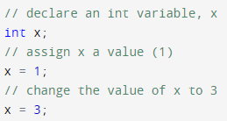


Assignment operators
Simple assignment operator =
Assigning right operand value to left operand
Declare an int variable, then assign it an integer value
Declare & assign in one line
Declare and assign multiple variables of the same type in one line

Slide 8
Assignment operators
Assignment by sum (+=), difference (-=), product (*=), quotient (/=), or remainder (%=)
Require the left operand to have a valid value before the assignment
They are effectively syntactic sugar:
x += 1; → x = x + 1; // the value of (x+1) is assigned to x. Therefore, there must be a valid // value stored in x, when we evaluate (x+1) in the first place
x /= 2; → x = x / 2;
The same rule applies to -=, *=, and %=
Simple assignment operator = has lower precedence than +, -, *, /, % operators
Associativity: right-to-left
int x = 2, y = 5;
x += y += 3;
do we group (x += y) first or (y += 3) first? → Do we associate operand y with its left += operator first or its right += operator first?
x = ?
y = ?
Notes:
x += y += 3 → x += (y+= 3) → x += 8 -> x = 10, y = 8

Slide 9
Assignment operators
Assignment by sum (+=), difference (-=), product (*=), quotient (/=), or remainder (%=)
Require the left operand to have a valid value before the assignment
They are effectively syntactic sugar:
x += 1; → x = x + 1; // the value of (x+1) is assigned to x. Therefore, there must be a valid // value stored in x, when we evaluate (x+1) in the first place
x /= 2; → x = x / 2;
The same rule applies to -=, *=, and %=
Simple assignment operator = has lower precedence than +, -, *, /, % operators
Precedence: +=, -= ,*=, /=, %= all have the same precedence -> follow their associativity to determine which expression to evaluate first
int x = 2, y = 5;
x -= y *= 3;
do we group (x -= y) first or (y *= 3) first? → Does -= have a higher precedence than *=? If no, what’s the associativity of these operators?
x = ?
y = ?
Notes:
x -= y *= 3 → x -= (y *= 3) → x -= (y = y * 3) -> y = 15, x -= 15 -> x = -13, y = 15

Slide 10
Arithmetic operators
Precedence and associativity of arithmetic operators follow their common mathematical counterparts
The operators are listed top to bottom, in descending precedence
i.e., *, /, % have higher precedence than +, -
Operator | Name | Precedence | Associativity | Example
* | multiplication | Same | Left-to-right | x * y (x multiplied with y)
/ | Division |  |  | x / y (x divided by y)
% | Remainder (modulo) |  |  | x % y (remainder of x divided by y)
+ | addition | Same |  | x + y (add y to x)
- | subtraction |  |  | x – y (subtract y from x)

Slide 11
Arithmetic operators
Precedence
E.g., what’s the value of 1 - 10 % 3 expression ?
Associativity
E.g., what’s the value of 36 / 3 / (2 + 1) expression ?
Operator | Name | Precedence | Associativity | Example
* | multiplication | Same | Left-to-right | x * y (x multiplied with y)
/ | Division |  |  | x / y (x divided by y)
% | Remainder (modulo) |  |  | x % y (remainder of x divided by y)
+ | addition | Same |  | x + y (add y to x)
- | subtraction |  |  | x – y (subtract y from x)
Notes:
1 – 10 % 3 = 1 – (10 % 3) = 1 – 1 = 0
36 / 3 / (2 + 1) = (36 / 3) / (2 + 1) = (12) / (3) = 4

Slide 12
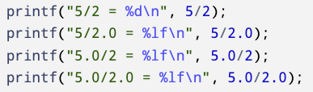
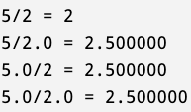
Arithmetic operators
Division operator
If both operands of division operator are integral types, division operation results in an integral value discarding the values after the decimal points
Unless one of the operands of division is floating-point number, the results of division will always be an integer
Relates to implicit type conversions

Slide 13
Common unary operators
Unary operators: apply to one operand
The operators are listed top to bottom, in descending precedence
Operator | Name | Precedence | Associativity | Example
++ | Postfix increment | Same | Left-to-right | x++ (increase value of x by 1)
-- | Postfix decrement |  |  | x-- (decrease value of x by 1)
++ | Prefix increment | Same | Right-to-left | ++x (increase value of x by 1)
-- | Prefix decrement | Same |  | --x (decrease value of x by 1)
+ | Unary plus | same |  | +x (doesn’t change x’s value)
- | Unary minus |  |  | -x (return the value of x with its sign flipped)

Slide 14
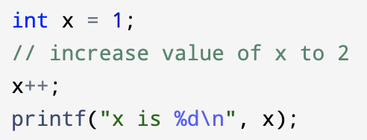

postfix increment/decrement
Postfix increment/decrement operators will modify the value of its operand by 1
Postfix increment/decrement together with its one operand forms an expression:
E.g., x++, increase value of x by 1
E.g., y--, decrease value of y by 1
Recall that each expression will evaluate to a value, assuming x = 1, what’s the value of the following 2 expressions: x++, x--?

Slide 15
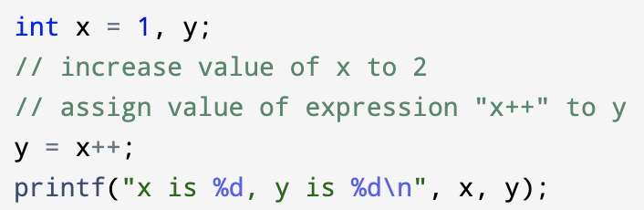

postfix increment/decrement
The value of an expression with postfix increment/decrement operator equals to the value of the operand before the operator applies to it
The value of expression “x++” (i.e., value of x before applying ++) is assigned to y, then ++ is applied to x to change its value to 2
Note, postfix increment/decrement operators have higher precedence than simple assignment operator =

Slide 16
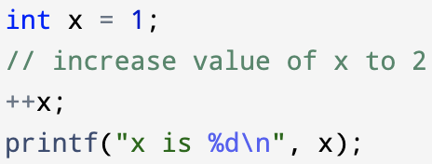
prefix increment/decrement
Prefix increment/decrement operators will modify the value of its operand by 1
Prefix increment/decrement together with its one operand forms an expression:
E.g., ++x, increase value of x by 1
E.g., --y, decrease value of y by 1
Recall that each expression will evaluate to a value, assuming x = 1, what’s the value of the following 2 expressions: ++x, --x?

Slide 17
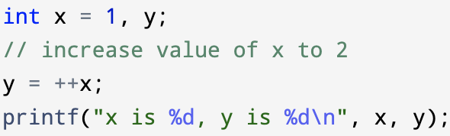

prefix increment/decrement
The value of an expression with prefix increment/decrement operator equals to the value of the operand after the operator applies to it
The value of expression “++x” (i.e., value of x after applying ++) is assigned to y
Note, prefix increment/decrement operators have higher precedence than simple assignment operator =

Slide 18
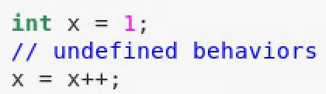
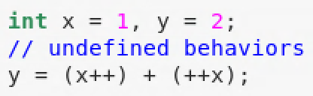
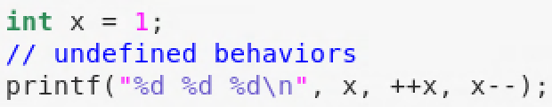
Arithmetic operators – undefined behavior
Both increment/decrement operator and assignment operator apply to the same operand in an expression
More than one increment/decrement operators apply to the same operand in an expression
Passing expressions of increment/decrement operators applied to the same operand as input arguments of a function
You may use –Wall option in gcc to ask the compiler to issue warnings when potential undefined behavior is detected by the compiler

Slide 19
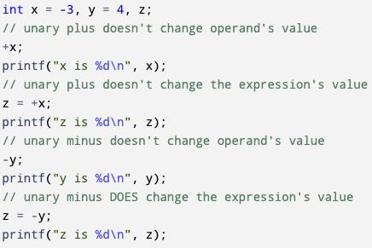

Arithmetic operators
Unary plus
Doesn’t change operand’s value
Doesn’t change the corresponding expression’s value
Unary minus
Doesn’t change operand’s value
Does change the expression’s value to have the opposite sign of the associated operator

Slide 20
Relational operators
Relational operators are used to compare the two operands
Relational operators return integer 0 or 1
0 stands for false
1 stands for true
The operators are listed top to bottom, in descending precedence
Operator | Name | Precedence | Associativity | Example
< | Less than | same | Left-to-right | 3 < 3, evaluates to 0
<= | Less than or equal to |  |  | 3 <= 3, evaluates to 1
> | Greater than |  |  | 3 > 4, evaluates to 0
>= | Greater than or equal to |  |  | 3 >= 4, evaluates to 0
== | Equal to | same |  | 3 == 3, evaluates to 1
!= | Not equal to |  |  | 3 != 3, evaluates to 0

Slide 21
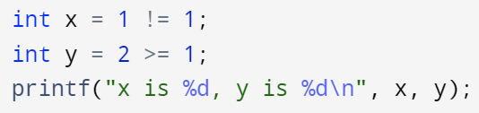

Relational operators
Relational operators return integer 0 (false) or 1 (true)
Relational operators have higher precedence than simple assignment operator
int x = 1 != 1; -> int x = (1 != 1); // assign value of 1 != 1 expression to x
>, >=, <, <= have higher precedence than == and !=
int x = 1 > 2 != 1; what’s the value of x?
int y = 1 > (2 != 1); what’s the value of y?
>, >=, <, <=, ==, and != have left-to-right associativity
int x = 3 > 2 > 1; what’s the value of x?
int y = 1 != 2 == 2; what’s the value of y?
Notes:
x = 1>2 != 1; -> x = (1>2) != 1 -> x = 0 != 1; -> x = 1;
y = 1 > (2 != 1); -> y = 1>1; -> y = 0;
x = 3 > 2 > 1; -> x = (3 > 2) > 1; -> x = 1 > 1; -> x = 0;
y = 1 ! = 2 == 2; -> y = (1 != 2) == 2; -> y = 0 == 2;

Slide 22
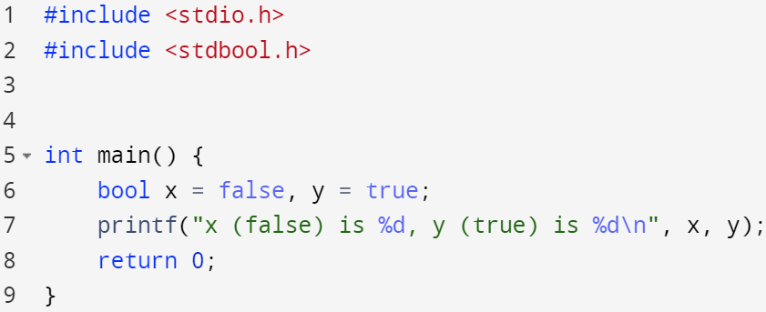

Logical operators – Boolean type
No Boolean type before C99
Add Boolean type by including header file stdbool.h
#include <stdbool.h>
Adds bool as a type keyword
Adds true (1) and false (0)
Boolean type is in essence an integer type
0 means false
Any integer other than 0 is true (including negative integers)

Slide 23
Logical operators
Logical operators return 0 (false) or 1 (true)
The operators are listed top to bottom, in descending precedence
C doesn’t have built-in logical exclusive-or (XOR) operator
Operator | Name | precedence | Associativity | Example
! | Logical NOT | 2 | Right-to-left | !0 is 1
 |  |  |  | !1 is 0
&& | Logical AND | 11 | Left-to-right | 1&&1 is 1
 |  |  |  | 1&&0 is 0
 |  |  |  | 0&&1 is 0
|| | Logical OR | 12 | Left-to-right | 1||1 is 1
 |  |  |  | 1||0 is 1
 |  |  |  | 0||0 is 0

Slide 24
Logical operators
Short-circuit evaluation
&& (AND) operator, if one operand is false, return false
(false) && (?) -> false, the second operand (?) is “short-circuited”/not evaluated
E.g.,
int x = 0, y = 1;
int z = (x < 0) && (++y);
What’s the value of z and y ?
|| (OR) operator, if one operand is true, return true
(true) || (?) -> true, the second operand (?) is “short-circuited”/not evaluated
E.g.,
int x = 0, y = 1;
int z = (x >= 0) || (y--);
What’s the value of z and y ?

Slide 25
Other common operators
Address-of operator: &
To fetch the memory address of a variable, e.g., scanf(“%d”, &x);
Doesn’t work on constants, e.g., &3, &'a'
Doesn’t work on expression &(x + y)
Ternary operator
A ? B : C, if A is true then return B, otherwise return C
int x = (1<2) ? 3 : -3; → if 1<2 is true, assign 3 to x, otherwise assign -3 to x
Bitwise operator
Designated to operate on integral types
Value of integral types in C are represented in binary numbers with 1s and 0s
Bitwise operator apply to the bits of integral values
To be introduced in detail after midterm

Slide 26
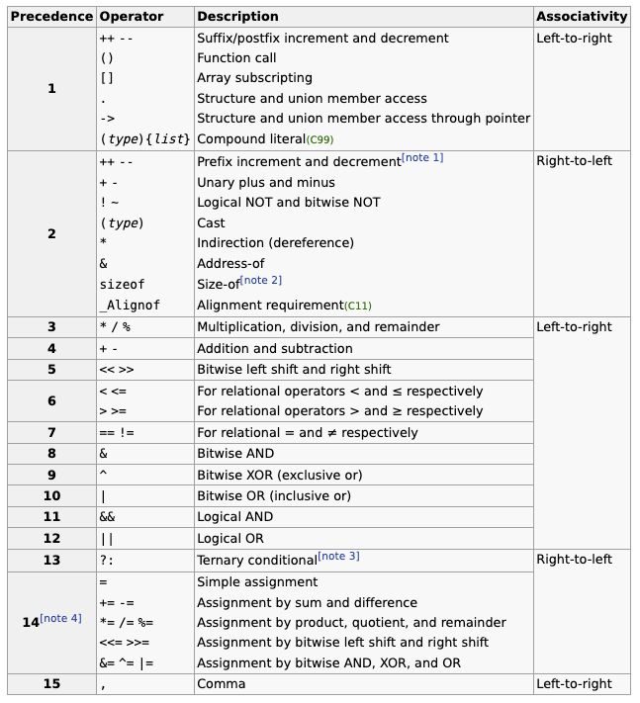
Precedence & Associativity of all operators
Operators are listed top to bottom in descending precedence
Increment/decrement > arithmetic > relational > logical > assignment operators
Source:
https://en.cppreference.com/w/c/language/operator_precedence

Slide 27
Type conversion/casting
Implicit type conversions
Expressions with mixed types operands
Assignment expressions
Function input arguments
Function return arguments
Explicit type conversions
Type conversion/casting operator: (type) operand
Notes:
Good Resource:
https://www.geeksforgeeks.org/implicit-type-conversion-in-c-with-examples/#:~:text=Implicit%20Type%20Conversion%20is%20also,one%20data%20type%20is%20present.

Slide 28

Type conversion – implicit conversion
Implicit conversion is done by the compiler automatically, the programmer does not need to type extra code to make it happen
Implicit type conversion generally take place when expressions have operands of different data types → all the data types are promoted to the largest type of variable occurred in the expression (except for assignment expression)
double
int

Slide 29
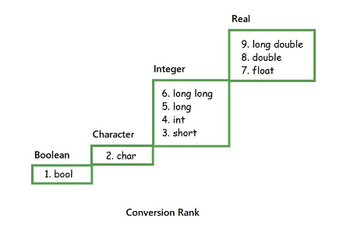
Type conversion – conversion rank
An expression with mixed data types:
Promotion: low-rank type (small type) convert to high-rank type (large type)
Demotion: high-rank type converts to low-rank type
Promotion will not lose precision of the the original value in general
Demotion will not lose precision of the original value if the original value is within the range of the new type
Lower rank types will be promoted to higher rank types automatically
Except for assignment expressions
Right operand of the assignment operator will be cast to the type of the left operand
E.g., left_operand = right_operand
E.g., left_operand /= right_operand
promotion

Slide 30
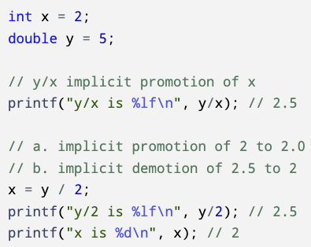
Type conversion
Implicit promotion
int x with value 2 is promoted to double with value 2.0
y/x → 5.0/2.0 → 2.5
Implicit demotion
x = y / 2 is an assignment expression
Assignment expression enforce type of right operand/expression to be converted to type of left operand
Right expression: y/2 → 5.0/2 → 5.0/2.0 → 2.5
Overall expression: x = 2.5, but x is of integral type → left operand is int → demote the right operand (2.5) to int → x = 2

Slide 31
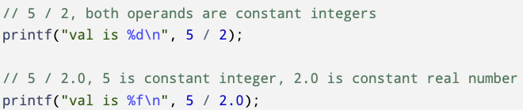
Type conversion - constants
Constants are also affected by type conversion rules
2 is constant integer
2.0 is constant real number, or constant floating-point number
What’s the value of 5 / 2?
What’s the value of 5/2.0?
Notes:
5/2 = 2
5/2.0 = 2.5

Slide 32
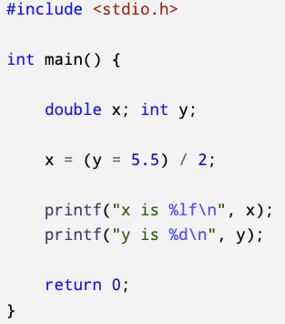
Type conversion - example
Value of the assignment expression
y = 5.5 as an assignment expression has the same value of left operand of the assignment operator, i.e., same value as y
y is an int → y = 5.5 will cast 5.5 to 5 → y = 5 → expression (y=5.5) has value of 5
Since y = 5, x = (y = 5.5) /2 → x = 5 / 2 =?

Slide 33
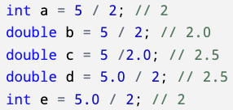
Type conversion - example
Revisiting example in slides 12 but add type conversions induced by assignment operator
Because variable e is declared as an integer, even though 5.0/2 has a value of 2.5, it is demoted to integer 2 in the assignment
Variable value | Expression value
2 | 2
2.0 | 2
2.5 | 2.5
2.5 | 2.5
2 | 2.5

Slide 34
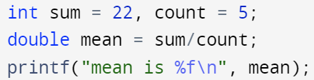

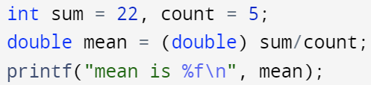

Type conversion - explicit conversion
In certain cases, you can’t rely on compilers to do implicit type conversions
e.g., average of a list of integers, the values in a list are all integers, no implicit promotion to double when computing the average
Use the cast operator to convert data types explicitly:
(type keyword) expression;
double x = (double) 5/2;
(double) will cast 5 to 5.0
5.0/2 will trigger implicit conversion of 2 to 2.0
Eventually, double x = 5.0/2.0, both sides of = are real numbers

